Slide 1
Intel® VTune™ Amplifier for Systems Generics

Slide 2
Agenda
Introduction to Intel® VTune™ Amplifier for Systems profiler
High-level Features
Types of Analysis
Hotspot analysis
Basic Hotspots
Advanced Hotspots
Lab 1: Find the Performance Hotspot
Concurrency Analysis
Lab 2: Analyzing Parallelism
Locks and Waits Analysis
Lab 3: Identifying Parallelism issues
User and Synchronization API, Frame/Task Analysis
Conclusion

Slide 3
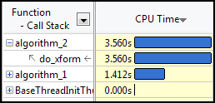
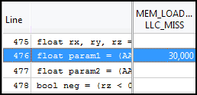
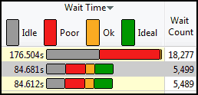
Intel® VTune™ Amplifier for Systems Performance Profiler
Where is my application…
Spending Time? | Wasting Time? | Waiting Too Long?
Focus tuning on functions taking time See call stacks See time on source | See cache misses on your source See functions sorted by # of cache misses | See locks by wait time Red/Green for CPU utilization during wait
Windows & Linux
Low overhead
No special recompiles
Advanced Profiling For Scalable Multicore Performance
Notes:
There is a GUI and command line version:
Windows: GUI can be as a plug-in to Microsoft’s Visual Studio or as a stand alone GUI
Linux: The GUI is a stand alone app. It does not have the Eclipse and SAP-EntireX software layers that the VTune™ Analyzer for Linux had.
Next generation collection refers to:
PIN instrumentation technology being used instead of the static binary instrumentation used for the older VTune™ Analyzer and Thread Profiler/Checker
Concurrency and Locks-And-Waits collectors used to characterize parallel performance issues
Integrated Timeline means that the Timeline is available as an additional pane in most of the common result screens, as opposed to being a separate screen that must be explicitly navigated to.

Slide 4
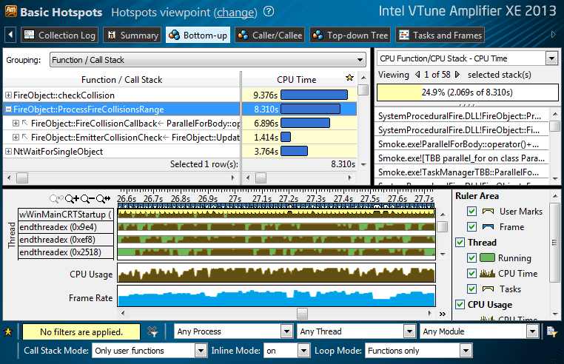
Intel® VTune™ Amplifier for Systems Tune Applications for Scalable Multicore Performance
Fast, Accurate Performance Profiles
Hotspot (Statistical call tree)
Call counts (Statistical)
Hardware-Event Sampling
Thread Profiling
Visualize thread interactions on timeline
Balance workloads
Easy set-up
Pre-defined performance profiles
Use a normal production build
Find Answers Fast
Filter extraneous data
View results on the source / assembly
Compatible
Microsoft, GCC, Intel compilers
C/C++, Fortran, Assembly, .NET, Java
Latest Intel® processors and compatible processors¹
Windows or Linux
Visual Studio Integration (Windows)
Standalone user i/f and command line
32 and 64-bit
¹ IA32 and Intel® 64 architectures. Many features work with compatible processors. Event based sampling requires a genuine Intel® Processor.
Notes:
Accurate performance data – Without data you are just guessing about the location of the performance bottleneck and can easily waste a lot of time.
Easy set-up – We’ve added a number of pre-defined performance profiling experiments to the full custom capabilities of earlier versions of VTune™ analyzer. This makes it easier to get great profiling information without needing to know micro architectural details.
Powerful profile analysis – Getting good profiling data is only the first step. We’ve added a number of features like the timeline, filtering and frame analysis to help turn that data into actionable information.
Tune threaded and non-threaded code – Identify the threads and synchronization objects which impact performance. See the distribution of work to threads and pinpoint load imbalances.
Low overhead – Collecting data always has a cost. VTune™ Amplifier XE keeps the overhead low making data collection faster and the results more accurate.
Normal production build – Use a production build with symbols from your normal compiler or assembler. No special builds are required.
C++, Fortran, Assembly and more – Use compilers from any vendor (Microsoft, GCC, Intel, …) that follow platform standards.
Intel® processors and compatible processors (IA32 & Intel® 64) – Many of the profiling features work on both genuine Intel® processors and compatible processors. Some features, which use the on-chip performance monitoring unit for event based sampling, require a genuine Intel® processor for data collection, but the results can be saved and analyzed on any compatible processor.
Windows or Linux, 32 and 64-bit – Both Windows and Linux versions are available. Windows 7, Vista, XP, Windows Server, RHEL, Fedora, Suse…
Windows: Visual Studio 2005, 2008 and 2010 Integration – Integrate performance analysis into the Visual Studio environment or run standalone.
Linux: No root privileges required – Root privileges are not required for basic performance analysis. Installation of the driver for event based sampling (EBS) requires root access, but it can be done later if needed.

Slide 5
A set of instruments to identify performance problems
Quick Overview

Slide 6
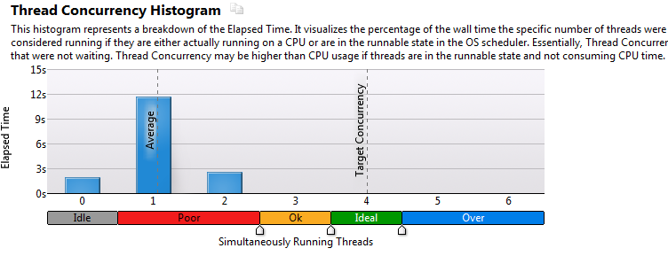
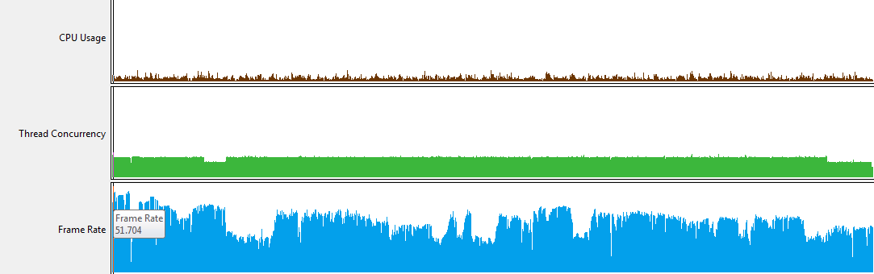
Intel® VTune™ Amplifier for Systems Get a quick snapshot
4 cores
CPU
Usage
Thread
Concurrency
Frame
Rate
6

Slide 7
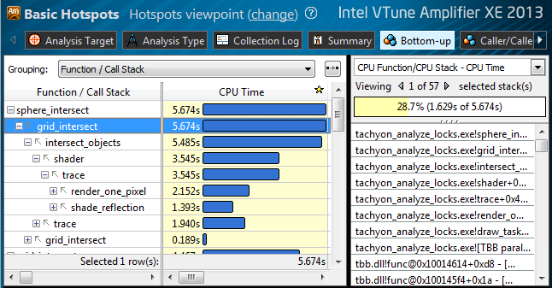
Intel® VTune™ Amplifier for Systems Identify hotspots
Hottest Functions
Hottest Call Stack
Quickly identify what is important

Slide 8
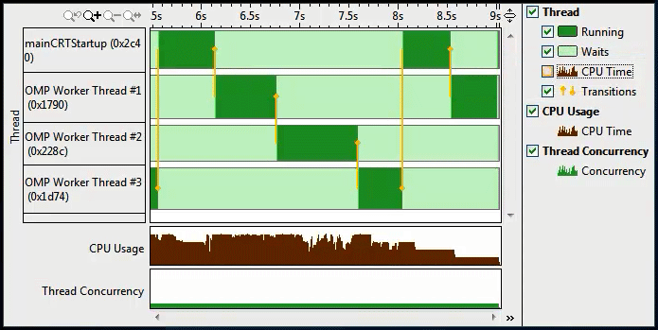
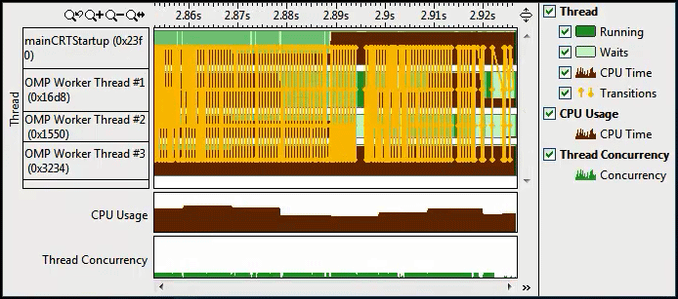
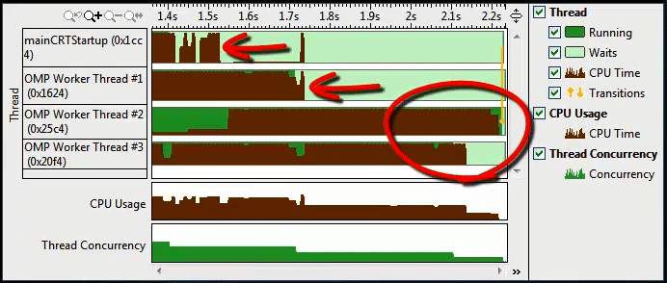
Intel® VTune™ Amplifier for Systems Identify threading inefficiency
Coarse Grain Locks
High Lock Contention
Low Concurrency
Load Imbalance

Slide 9
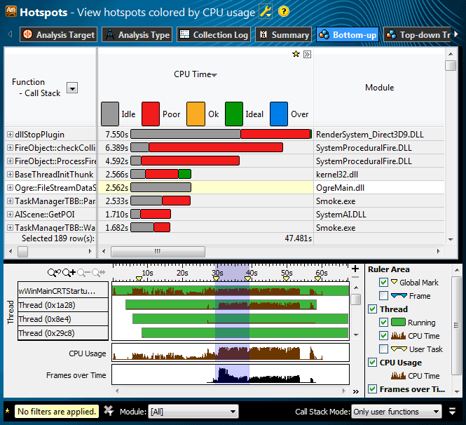
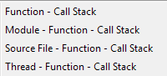
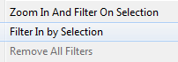
Intel® VTune™ Amplifier for Systems Find Answers Fast
Adjust Data Grouping
… (Partial list shown)
Click [+] for Call Stack
Double Click Function
to View Source
Filter
by Timeline Selection
(or by Grid selection)
Filter by Module & Other Controls

Slide 10
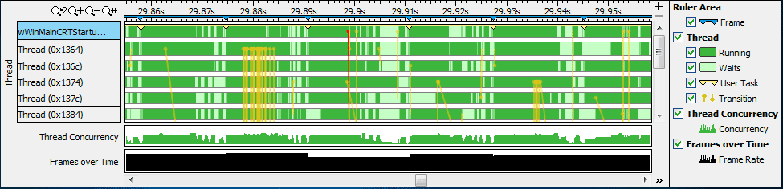
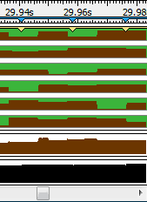
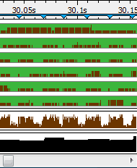


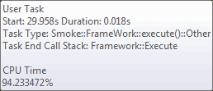

Intel® VTune™ Amplifier for Systems Timeline Visualizes Thread Behavior
Transitions
CPU Time
Locks & Waits
Hotspots
Lightweight Hotspots
Hovers:
Optional: Use API to mark frames and user tasks
Optional: Add a mark during collection

Slide 11
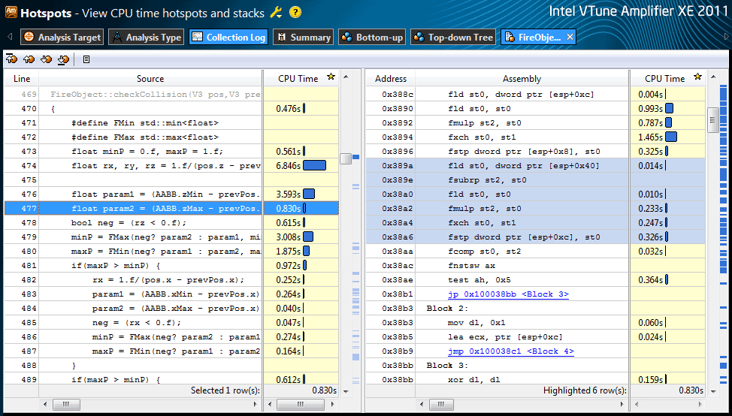
Intel® VTune™ Amplifier for Systems See Profile Data On Source / Asm
Time on Source / Asm
Quick Asm navigation:
Select source to highlight Asm
Right click for instruction reference manual
Quickly scroll to hot spots.
Click jump to scroll Asm
Intel® VTune™ Amplifier XE

Slide 12
High-level Features

Slide 13
Intel® VTune™ Amplifier for Systems Feature Highlights
Basic Hot Spot Analysis (Statistical Call Graph)
Locates the time consuming regions of your application
Provides associated call-stacks that let you know how you got to these time consuming regions
Call-tree built using these call stacks
Advanced Hotspot and architecture analysis
Based on Hardware Event-based Sampling (EBS)
Pre-defined tuning experiments
Thread Profiling
Visualize thread activity and lock transitions in the timeline
Provides lock profiling capability
Shows CPU/Core utilization and concurrency information
GPU Compute Performance Analysis
Collect GPU data for tuning OpenCL applications. Correlate GPU and CPU activities

Slide 14
Intel® VTune™ Amplifier for Systems Feature Highlights
Attach to running processes
Hotspot and Concurrency analysis modes can attach to running processes
System wide data collection
EBS modes allows system wide data collection and the tool provides the ability to filter this data
GUI
Standalone GUI available on Windows* and Linux
Microsoft* Visual Studio integration
Command Line
Comprehensive support for regression analysis and remote collection
Platform & application support
Windows* and Linux (Android, Tizen, Yocto – in the ISS)
Microsoft* .NET/C# applications
Java* and mixed applications
Fortran applications

Slide 15
Intel® VTune™ Amplifier for Systems Feature Highlights
Event multiplexing
Gather more information with each profiling run
Timeline correlation of thread and event data
Populates thread active time with event data collected for that thread
Ability to filter regions on the timeline
Advanced Source / Assembler View
See event data graphed on the source / assembler
View and analyze assembly as basic blocks
Review the quality of vectorization in the assembly code display of your hot spot
Provides pre-defined tuning experiments
Predefined profiles for quick analysis configuration
A user profile can be created on a basis of a predefined profile
User API
Rich set of user API for collection control, events highlighting, code instrumentation, and visualization enhancing.

Slide 16
Data Collectors and Analysis Types

Slide 17
Intel® VTune™ Amplifier for Systems Analysis Types (based on technology)
Software Collector Any x86 processor, any virtual, no driver | Hardware Collector Higher res., lower overhead, system wide
Basic Hotspots Which functions use the most time? | Advanced Hotspots Which functions use the most time? Where to inline? – Statistical call counts
Concurrency Tune parallelism. Colors show number of cores used. | General Exploration Where is the biggest opportunity? Cache misses? Branch mispredictions?
Locks and Waits Tune the #1 cause of slow threaded performance – waiting with idle cores. | Advanced Analysis Dig deep to tune bandwidth, cache misses, access contention, etc.

Slide 18
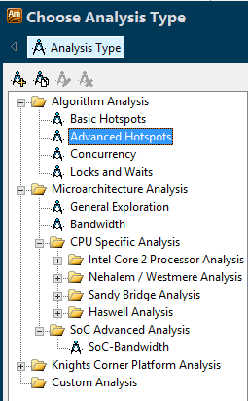
Intel® VTune™ Amplifier for Systems Pre-defined Analysis Types
Advanced Hotspot analysis based on the underlying architecture
User mode sampling, Threading, IO, Signaling API instrumentation
3rd Generation Core Architecture (a.k.a SandyBridge) analysis types
4th Generation Core Architecture (a.k.a Haswell) analysis types

Slide 19
GUI Layout

Slide 20
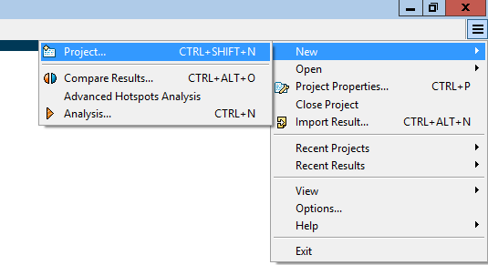
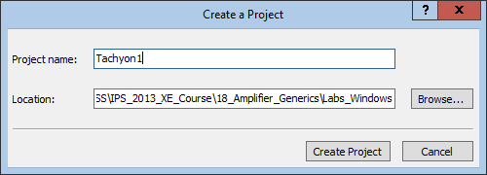
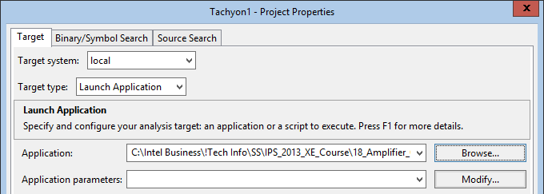
Creating a Project GUI Layout
1
2
3

Slide 21
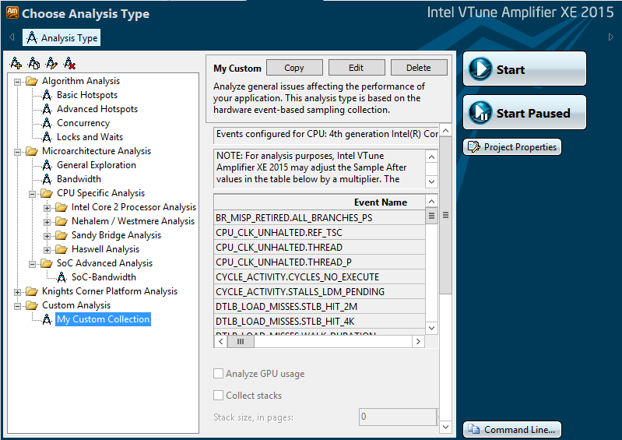
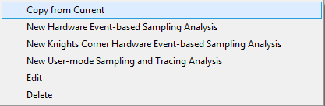
Selecting type of data collection GUI Layout
All available analysis types
Different ways to start the analysis
Helps creating new analysis types
Copy the command line to clipboard

Slide 22

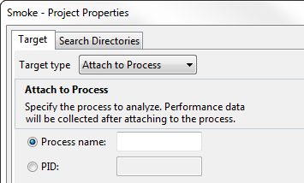
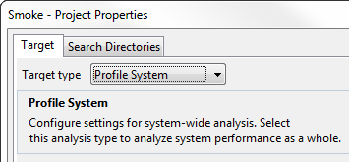
Profile a Running Application No need to stop and re-launch the app when profiling
Two Techniques:
Attach to Process:
Profile System:
- Any type of analysis
- Advanced Hotspots & Custom EBS
- Optional: Filter by process after collection

Slide 23
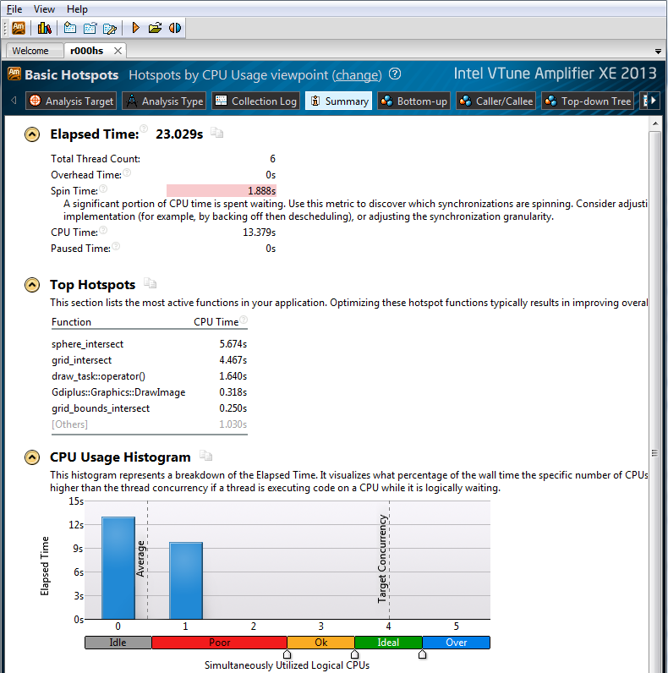
Summary View GUI Layout
Clicking on the Summary tab shows a high level summary of the run
Timing for the whole application run
List of 5 Hotspot functions
CPU Usage

Slide 24
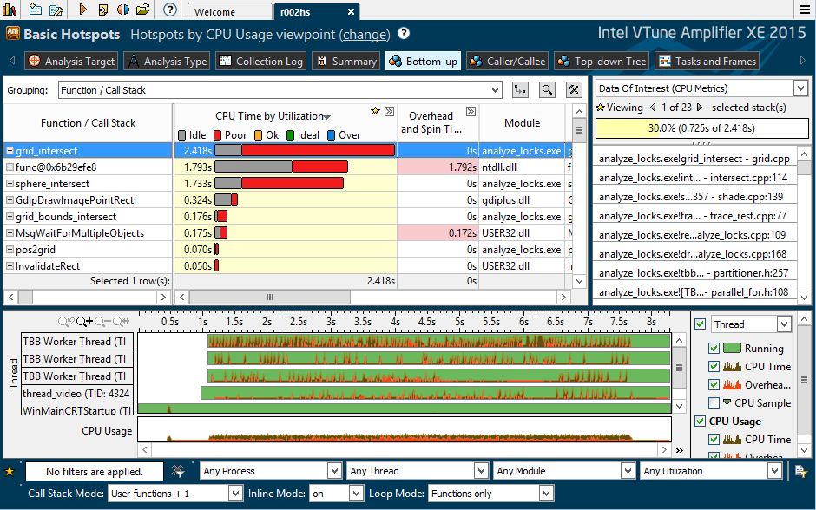
Bottom-Up View GUI Layout
Menu and Tool bars
Analysis Type
Viewpoint currently being used
Tabs within each result
Current grouping
Grid area
Stack Pane
Filter area
Timeline area

Slide 25
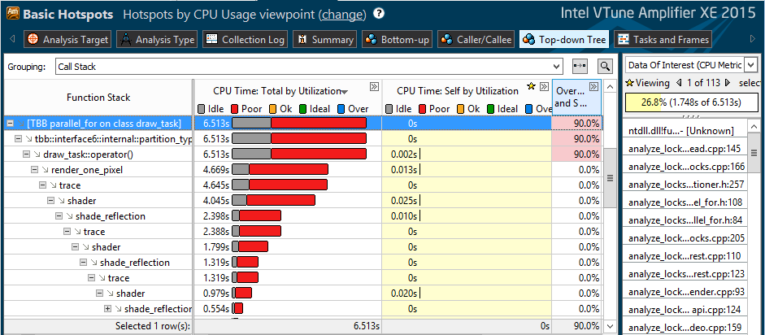
Top-Down View GUI Layout
Clicking on the Top-Down Tree tab changes stack representation in the Grid
Top-level function and it’s tree
Self Time
Total Time
(self + children’s)

Slide 26
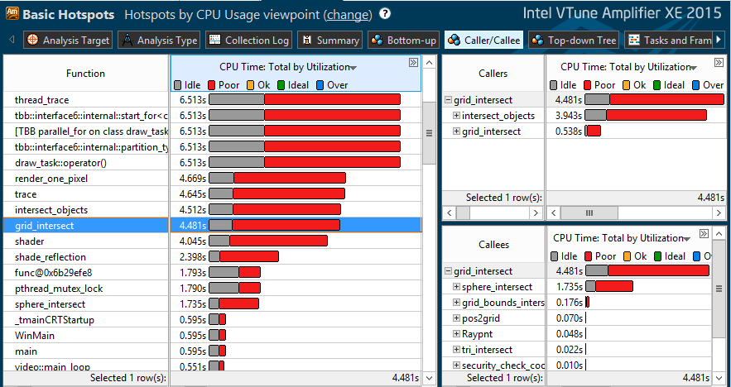
Caller/Callee View GUI Layout
Select a function in the Bottom-Up and find the caller/callee
List of functions sorted by CPU Time
List of callers and their stacks
List of callees and their stacks

Slide 27
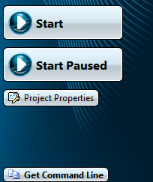
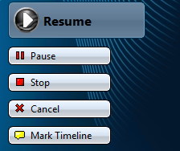
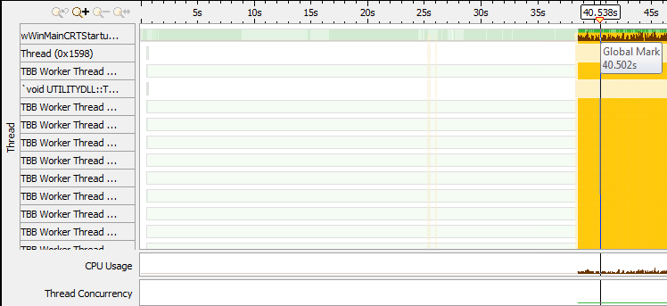
Adding User Marks to the Timeline GUI Controls
Resume data collection when needed
Start application without data collection
Observe paused region on the Time Line
Click “Mark Timeline” during collection
Observe the mark on the Time Line

Slide 28
Key Result Analysis and GUI Concepts

Slide 29

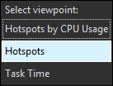
Result Analysis GUI Concepts
Viewpoints
It is a pre-defined view that determines what needs to be displayed in the grid and timeline for a given analysis type
An analysis type may support more than one view points
To change viewpoints, select a viewpoint by clicking on
Click

Slide 30
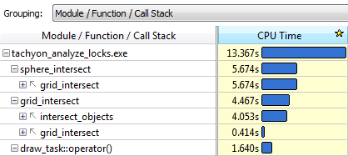
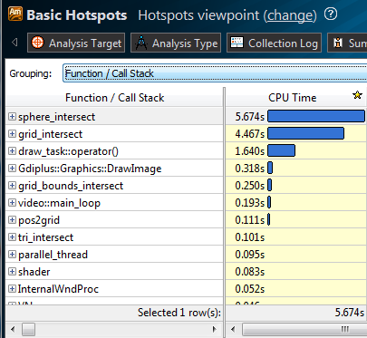
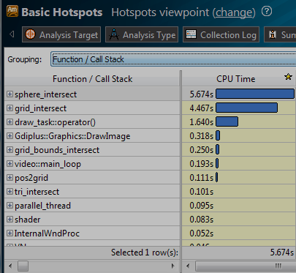
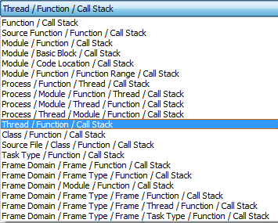
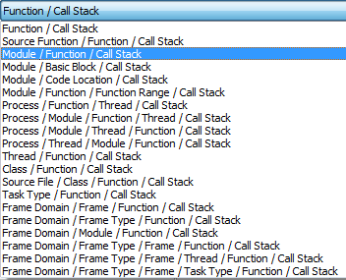
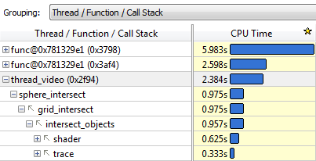
Result Analysis GUI Concepts
Groupings
Each analysis type has many viewpoints
Each viewpoint has pre-defined groupings
Allows you to analyze the data in different hierarchies and granularities
Click

Slide 31
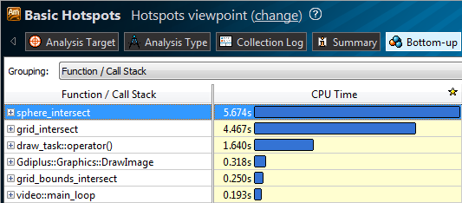
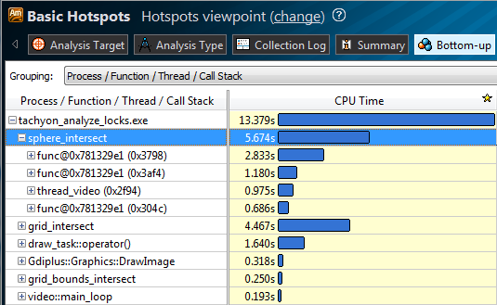
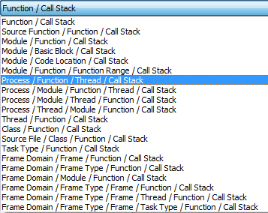
Viewpoints and Groupings
For example, pre-defined groupings can be used to determine load imbalance
Change to Function/Thread

Slide 32
Key Concepts Results Comparison
VTune™ Amplifier for Systems allows comparison of two similar runs
Extremely useful for:
Benchmarking
Regression analysis
Testing
During performance optimization work source code may change
Binary recompiled: compare based on source function
Inside a function: compare based on functions level
Functions changed: group by source files and compare
Source files changed: compare by modules

Slide 33
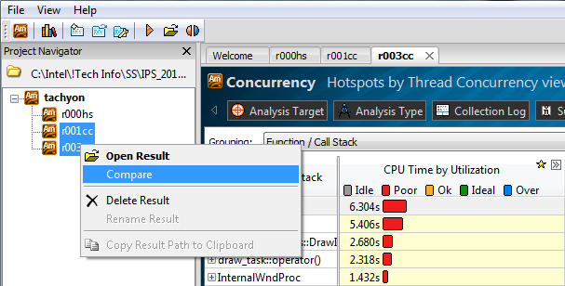
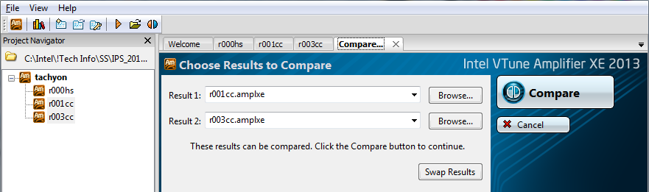
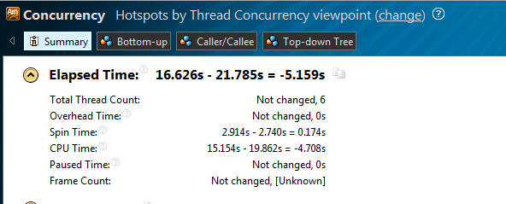
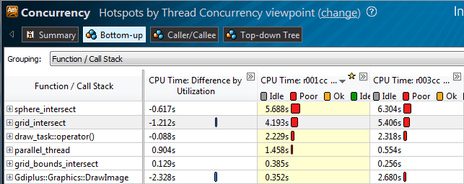
Results Comparison

Slide 34
Analysis Types Revisited Lab Activities

Slide 35
Reminding the methodology of performance profiling and tuning
The Goal: minimize the time it takes your program / module / function to execute
Identify Hotspots and focus on them
It’s just a few functions (20% of code does 80% of job)
Optimize them (with compiler or hand optimizations)
Check for hotspots again, and find new ones
How to optimize the Hotspots?
Maximize CPU utilization and minimize elapsed time
Ensure CPU is busy all the time
All Cores busy – parallelism
Busy with useful tasks
Optimize tasks execution

Slide 36
Performance profiling Terminology
Elapsed Time The total time your target application ran. Wall clock time at end of application – Wall clock time at start of application
CPU Time The amount of time a thread spends executing on a logical processor. For multiple threads, the CPU time of the threads is summed.
Wait Time The amount of time that a given thread waited for some event to occur, such as: synchronization waits and I/O waits

Slide 37
Performance profiling CPU Usage
Thread1
Waiting
Thread1
Thread2
Waiting
Thread2
Thread3
Waiting
Thread3
Thread running
1sec
1sec
1sec
1sec
1sec
1sec
Thread waiting
Elapsed Time: 6 seconds
CPU Time: T1 (4s) + T2 (3s) + T3 (3s) = 10 seconds
Wait Time: T1(2s) + T2(2s) + T3 (2s) = 6 seconds
CPU Usage
0
1
2
3
4

Slide 38
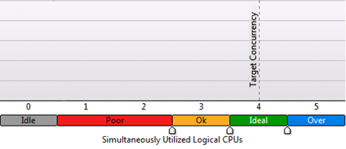
CPU Usage How it’s presented by VTune Amplifier
Summary View: CPU Usage Histogram
Only CPU Time measured
Wait Time is not counted in Hotspots
Bottom-Up View: CPU Time
Function | CPU Time | By CPU Utilization
My_Func() | 10 s

Slide 39
Performance profiling Overhead and spin
Threading library internals
Thread1
Waiting
lib
Thread1
Thread2
Waiting
lib
Thread2
Thread3
user code
Waiting
Thread3
lib running or spin
Spin wait
Thread running
1sec
1sec
1sec
1sec
1sec
1sec
Thread waiting
Elapsed Time: 6 seconds
CPU Time: T1 (4s) + T2 (3s) + T3 (3s) = 10 seconds
Wait Time: T1(2s) + T2(2s) + T3 (2s) = 6 seconds
Overhead and spin Time: T1(1s) + T2(1s) + T2(1s) = 3 s
CPU Usage
0
1
2
3
4

Slide 40
CPU Usage How it’s presented by VTune Amplifier
Summary View: CPU Usage Histogram
Overhead and Spin Time is not counted for CPU Usage
Bottom-Up View: CPU Time
Function | CPU Time | By CPU Utilization | Overhead and Spin Time
My_Func() | 10 s |  | 4 s

Slide 41
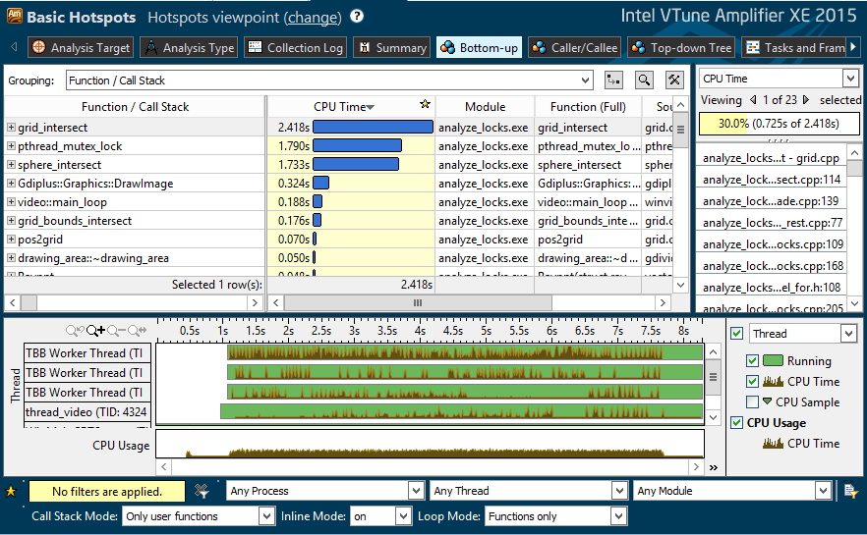
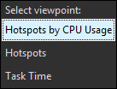

Hotspots analysis Hotspot functions
Hotspot Functions
Change Viewpoint
Adjust Data Grouping
… (Partial list shown)
Function CPU time
Call stack
Click [+] for Call Stack
Thread timeline
Filter by Timeline Selection (or by Grid Selection)
Filter by Module & Other Controls
Notes:
The function hotspot shows the functions that consumed the most CPU time.
The Call stack shows the function-to-function calling sequences that generated the most CPU time. This is the Statistical Call Graph that was referred to eariler.
The different threads of the program are shown in the timeline, along with their CPU usage.

Slide 42

Hotspots analysis Hotspot functions by CPU usage
Double Click Function
to View Source
Overhead and Spin Time
Coloring CPU Time by CPU Utilization
Overhead and Spin on Timeline

Slide 43

Hotspots analysis Source View
Source View
Assembly View
Self and Total Time on Source / Asm
Right click for instruction reference manual
Quick Asm navigation:
Select source to highlight Asm
Click jump to scroll Asm
Quickly scroll to hot spots.
Scroll Bar “Heat Map” is an overview of hot spots
Notes:
The source code and its compiled code is shown in a side-by-side manner. Notice the “heat map” vertical bars to the right of the vertical scroll bars. They indicate which portions of the source file contain the most CPU time. Also notice that the source view display initially highlights the source statement that has the most CPU time, not just the start of the function.

Slide 44

Find the Performance Hotspot Lab 1

Slide 45

Advanced Hotspot analysis
Uses Intel’s CPU hardware performance collectors
Higher resolution of sampling (~1 /ms)
Capable for system wide analysis (all processes running in a system)
OS modules and drivers profiling (ring 0 level)
OS context switches and threads synchronization issues
Start the Analysis
Advanced Hotspot Analysis
Select sampling interval
Select level of data collected

Slide 46
Reminding methodology of performance profiling and tuning
How to optimize the Hotspots?
Maximize CPU utilization and minimize elapsed time
Ensure CPU is busy all the time
All Cores busy – parallelism (high concurrency)
Elapsed (Serial)
Serial
Time
T1
T2
Elapsed (N-threads)
T3
T4
Gain
Time
Elapsed (Serial) / N
4T optimal
Potential Gain
Time

Slide 47
Performance profiling Concurrency
Concurrency -
Is a measurement of the number of active threads
Thread1
Waiting
Thread1
Thread2
Waiting
Concurrency Summary
Thread2
Thread3
Waiting
Thread3
0
1
2
3
4
Thread running
1sec
1sec
1sec
1sec
1sec
1sec
Thread waiting
Notes:
The graph at the bottom shows that there were 3 time periods in which only 1 CPU was executing, 2 time periods in which 2 CPUs were executing, and 1 time period in which there were 3 CPUs executing.

Slide 48

Parallelism/Concurrency Analysis
For Parallelism / Concurrency analysis,
Stack sampling is done just like in Hotspots analysis
Wait functions are instrumented (e.g. WaitForSingleObject, EnterCriticalSection)
Signal functions are instrumented (e.g. SetEvent, LeaveCriticalSection)
I/O functions are instrumented (e.g. ReadFile, socket)
Start the Analysis
Concurrency Analysis

Slide 49

Concurrency Analysis Summary view. CPU Usage Histogram
There might be threads in active state, but not using CPU

Slide 50

Concurrency Analysis Bottom-Up view. CPU Usage
CPU Usage
Overhead
Wait
Overhead
Thread is waiting
Thread Transitions
Thread is running
Notes:
The Concurrency View that results from the Concurrency collector shows the amount of time spent on specific numbers of CPUs. This screen shows that the function sphere_intersect spent almost all of its time on a very few number of CPUs (the red color - in this case just 1 CPU). Very poor parallelism.
The yellow color in the timeline at the bottom of the screen show lock transitions – synchronization locks being released by one thread and acquired by another. It looks like there are a lot of these transitions – maybe an indication of too much synchronization overhead.

Slide 51


Concurrency Timeline Investigate reasons for transitions
Select and Zoom
Hover over a transition line

Slide 52

Concurrency Analysis Source Code View
CPU Usage coloring against source lines

Slide 53
Analyzing Parallelism Lab 2

Slide 54
Performance profiling Waiting on locks
Sync Object
Sync Object
Sync Object
Signal
Signal
Signal
Thread1
Waiting
Thread1
Idle
Thread2
Waiting
Thread2
Idle
Thread3
Waiting
Thread3
Thread running
1sec
1sec
1sec
1sec
1sec
1sec
Thread waiting
Begin main thread
End main thread
Calculating Wait and Idle time

Slide 55

Locks and Waits Analysis
Identifies those threading items that are causing the most thread block time
Synchronization locks
Threading APIs
I/O
Start the Analysis
Locks & Waits Analysis

Slide 56

Locks and Waits Analysis Sync/Wait objects
Grouping by Sync Object
Stack for the wait object
Wait Objects
CPU Utilization
Waits #
Object Type
Notes:
This result screen shows that there is a Mutex that caused a large amount of non-parallel, poor CPU concurrency time (shown as the red bar from the Mutex). The Call Stack entry shows that the function draw_task is the one that is referencing the Mutex.
Double-clicking on the highlighted Mutex results in the next slide

Slide 57

Locks and Waits Analysis Source View
Upper function
Wait count
Critical Section object upper on the stack
Waiting time on the object
Notes:
This shows the source code for where the Mutex is being acquired. This Mutex is only allowing one thread at a time to execute the for loop.

Slide 58
Finding Parallelism Issues Lab 3

Slide 59
Intel® VTune™ Amplifier for Systems User APIs
User APIs
Collection Control API
Thread Naming API
User-Defined Synchronization API
Task API
User Event API
Frame API
JIT Profiling API

Slide 60
User API
Enable you to
control collection
set marks during the execution of the specific code
specify custom synchronization primitives implemented without standard system APIs
To use the user APIs, do the following:
Include ittnotify.h, located at <install_dir>/include
Insert __itt_* notifications in your code
Link to the libittnotify.lib file located at <install_dir>/lib

Slide 61
User API Task APIs
A task is a logical unit of work performed by a particular thread
Tasks can be nested
You can use task APIs to assign tasks to threads
One thread executes one task at a given time
Tasks may correspond to functions, scopes, or a case block in a switch statement

Slide 62
User API Task APIs reference
Use This Primitive | To Do This
void __itt_task_begin ( const __itt_domain *domain, __itt_id taskid, __itt_id parentid, __itt_string_handle *name) | Create a task instance on a thread. This becomes the current task instance for that thread. A call to __itt_task_end() on the same thread ends the current task instance.
void __itt_task_end ( const __itt_domain *domain) | End a task instance on a thread.
Parameter | Description
__itt_domain | The domain of the task.
__itt_id taskid | This is a reserved parameter.
__itt_id parentid | This is a reserved parameter.
__itt_string_handle | The task string handle.

Slide 63
User API Task APIs example
__itt_domain* domain = __itt_domain_create(L"Task Domain");
__itt_string_handle* UserTask = __itt_string_handle_create(L"UserTask");
__itt_string_handle* UserSubTask = __itt_string_handle_create(L“UserSubTask");
int main(int argc, char* argv[])
{
...
__itt_task_begin (domain, __itt_null, __itt_null, UserTask);
//create many threads to call work()
__itt_task_end (domain);
...
}
work()
{
__itt_task_begin (domain, __itt_null, __itt_null, UserSubTask);
do_foo();
__itt_task_end (domain);
return 0;
}

Slide 64

Using Task API Hotspots analysis – Bottom-up view

Slide 65

Using Task API Hotspots analysis – Task view

Slide 66

Performance Profiling Frame Analysis
voidalgorithm_1();
voidalgorithm_2(int myid);
doubleGetSeconds();
DWORD WINAPI do_xform (void * lpmyid);
bool checkResults();
__itt_domain* pD = __itt_domain_create (“myDomain”);
while( gRunning ) {
__itt_frame_begin_v3(pD, NULL);
. . .
//Do Work
. . .
__itt_frame_end_v3(pD, NULL);
}
for (int k = 0; k < N; ++k) {
int ik = i*N + k;
int kj = k*N + j;
c2[ij] += a[ik]*b[kj];
}
Application
Frame Analysis –
Analyze Long Latency Activity
Frame: a region executed repeatedly (non-overlapping).
API marks start and finish
Auto detect DirectX frames
Examples:
Game – Compute next graphics frame
Simulator – Time step loop
Computation – Convergence loop
Region (Frame)

Slide 67



Remote Data Collection
Local System VTune™ Amplifier for Systems Full user interface
Remote System
Lightweight command line collector
ssh
Setup the experiment using GUI locally
Configure remote target connection*
Specify application to run
Run analysis and get results copied to the Host automatically.
*Need to establish a passwordless ssh-connection

Slide 68
Summary
The Intel® VTune Amplifier for Systems can be used to find:
Source code for performance bottlenecks
Characterize the amount of parallelism in an application
Determine which synchronization locks or APIs are limiting the parallelism in an application
Understand problems limiting CPU instruction level parallelism
Instrument user code for better understanding of execution flow defined by threading runtimes

Slide 69

Questions?

Slide 70
Legal Disclaimer & Optimization Notice
INFORMATION IN THIS DOCUMENT IS PROVIDED “AS IS”. NO LICENSE, EXPRESS OR IMPLIED, BY ESTOPPEL OR OTHERWISE, TO ANY INTELLECTUAL PROPERTY RIGHTS IS GRANTED BY THIS DOCUMENT. INTEL ASSUMES NO LIABILITY WHATSOEVER AND INTEL DISCLAIMS ANY EXPRESS OR IMPLIED WARRANTY, RELATING TO THIS INFORMATION INCLUDING LIABILITY OR WARRANTIES RELATING TO FITNESS FOR A PARTICULAR PURPOSE, MERCHANTABILITY, OR INFRINGEMENT OF ANY PATENT, COPYRIGHT OR OTHER INTELLECTUAL PROPERTY RIGHT.
Software and workloads used in performance tests may have been optimized for performance only on Intel microprocessors. Performance tests, such as SYSmark and MobileMark, are measured using specific computer systems, components, software, operations and functions. Any change to any of those factors may cause the results to vary. You should consult other information and performance tests to assist you in fully evaluating your contemplated purchases, including the performance of that product when combined with other products.
Copyright © 2014, Intel Corporation. All rights reserved. Intel, Pentium, Xeon, Xeon Phi, Core, VTune, Cilk, and the Intel logo are trademarks of Intel Corporation in the U.S. and other countries.
Optimization Notice
Intel’s compilers may or may not optimize to the same degree for non-Intel microprocessors for optimizations that are not unique to Intel microprocessors. These optimizations include SSE2, SSE3, and SSSE3 instruction sets and other optimizations. Intel does not guarantee the availability, functionality, or effectiveness of any optimization on microprocessors not manufactured by Intel. Microprocessor-dependent optimizations in this product are intended for use with Intel microprocessors. Certain optimizations not specific to Intel microarchitecture are reserved for Intel microprocessors. Please refer to the applicable product User and Reference Guides for more information regarding the specific instruction sets covered by this notice. Notice revision #20110804

